Slide 1
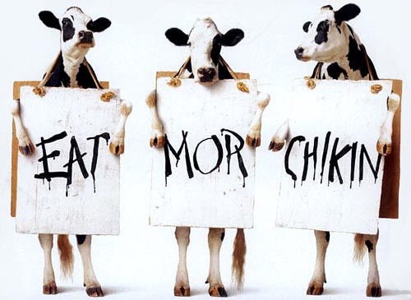
Congruence in Grammar

Slide 2
“S” form
I am English.
You are Norwegian.
He/she/it is Danish (Jone is Danish, my aunt is Danish, the cat is Danish and my car is Swedish)
We are Europeans.
They are Americans.

Slide 3

Asking questions with “Are” and “Is”
Are you Scottish? No, I am English.
You are Polish aren’t you? Yes I am.
Is Jone Danish? Yes, he is.
Is your aunt Australian? No, she’s Armenian.
Where is your car from? It’s from Sweden.
Are you all Europeans? No, Carlo is Mexican,
and we are Syrian.

Slide 4
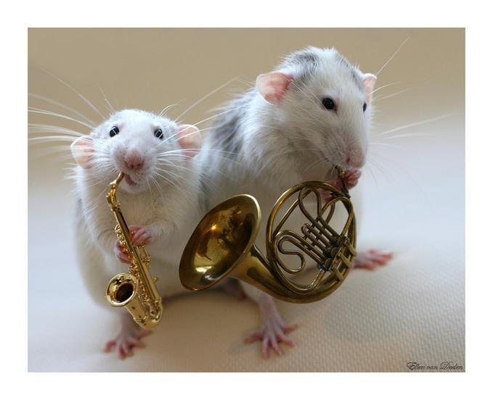

“S” on verb
I like jazz music
You like pop music.
Edward likes country music, Emily likes blues music and Steve likes classical music.
John and James like hip-hop

Slide 5
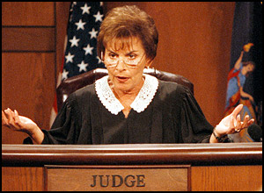
WHO are you talking about?
Judge Judy
(3rd person singular)One person. She isn’t me and she isn’t you.
I am a patient person. I like music.
You are a patient person. You like grammar.
Judge Judy is an angry person. She likes small dogs.
Elephants are large animals. They like water.

Slide 6

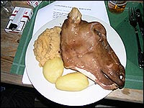
In English we need auxiliary verbs (hjelpeverb) when we ask questions
Liker du mat? (Norwegian)
Like you food? (Norwinglish)
You like food?(English word order-subject, verb object)
Do you like Norwegian food?

Slide 7
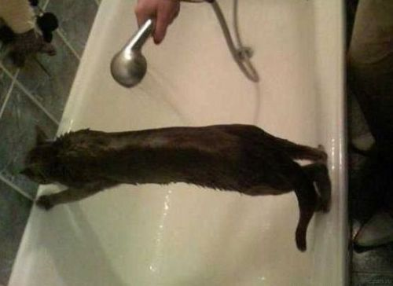
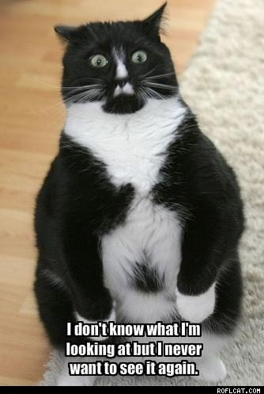

And when we use negatives
Cats don’t like getting wet
Most people don’t like going to the dentist

Slide 8
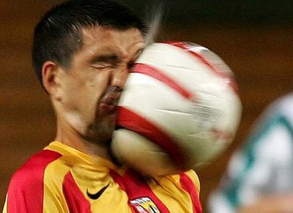
But the auxiliary changes with the third person
He likes football
Do
you like football?
Do
he like football?
Does
Why does he like football? Does anyone know?
(anyone, anything, everyone etc are classed as singular in grammar)

Slide 9
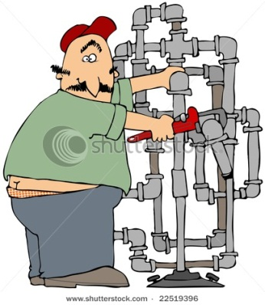
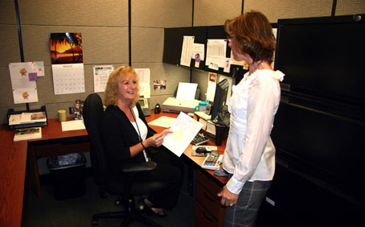
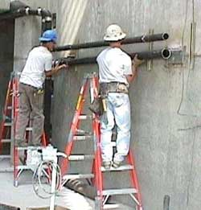
Questions and Negatives at work
Do project managers have frequent meetings?
Yes, they often do.
Do they hold safety courses?
No, they don’t. The HSE officer does that.
Does a new employee get instructions on emergency procedures?
Yes, she does. (Yes, they do)
Do you think that protective clothing is necessary?
Does your colleague agree?
Yes, he does. He thinks that helmets are especially important.

Slide 10

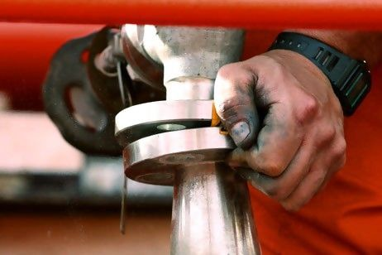
Do you provide advice on company insurance?
Does the accounts department check new tax laws regularly?
How often do you calibrate this machine?
How often does an inspector refuse to certify a weld?
Do employees often ask advice on safety procedures?
I believe they do.
Does the supervisor provide information on holiday pay?
Yes, she does, but the HR manager usually provides details on company policy.
Does the HR department provide protective equipment for visitors?
Yes, it does. But the procurement department ensures that there are enough in stock.

Slide 11
More examples
Does the accounts department check new tax laws regularly?
John calibrates this machine at least every week but we calibrate the other machines every month.
We try to ensure that a company inspector certifies all welds but often we must certify welds using external inspectors.
Employees seldom ask for advice on safety procedures, but Celia asks quite frequently.
The supervisor provides information on holiday dates, but the HR department provides information on holiday pay.
The Security department supplies identity badges for visitors, but the Procurement office supplies protective equipment.
The procurement department ensures that there are enough in stock.

